Slide 1
FACE MASK DETECTION
USING OpenCV & Haarcasecade
<Team: project X> Fci fayoum year 1
Supervised by: Dr/Esraa EL-hariri

Slide 2
TABLE OF CONTENTS
01
02
03
04
Introduction
Methodolgy
Applications
Our Team

Slide 3
01
Introduction

Slide 4
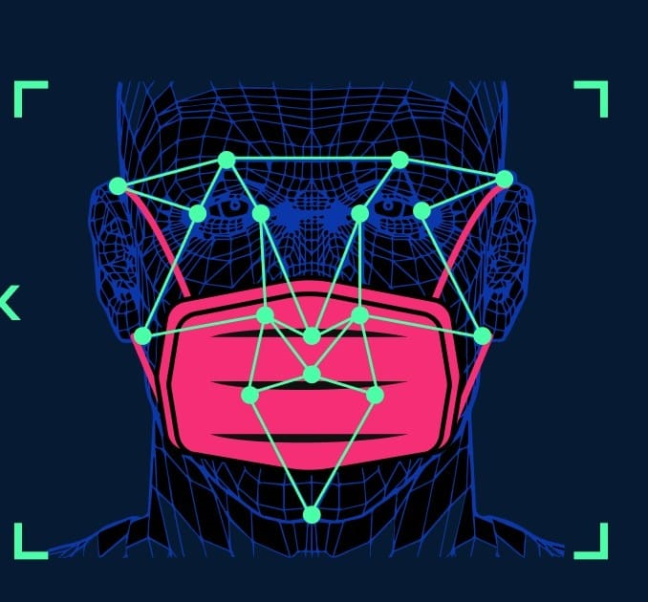
INTRODUCTION
The global covid-19 pandemic has caused a major disrupt in our everyday life, because of this pandemic mask has become a part of our face now. Everyone has to wear a mask whenever they go out to public places to keep themselves safe.
Objective
This project is aimed to detect and differentiate faces with and without
mask which will really be useful by companies or schools etc..
to detect people who are not wearing a mask.

Slide 5

What is OpenCV? OpenCV is the huge open-source library for the computer vision, machine learning, and image processing and now it plays a major role in real-time operation which is very important in today’s systems. By using it, one can process images and videos to identify objects, faces, or even handwriting of a human

Slide 6

What is HAAR Cascade?
So what is Haar Cascade? It is an Object Detection Algorithm used to identify faces in an image or a real time video. The algorithm uses edge or line detection features The algorithm is given a lot of positive images consisting of faces, and a lot of negative images not consisting of any face to train on them. The model created from this training is available at the OpenCV
The OpenCV repository has the models stored in XML files, and can be read with the OpenCV methods. These include models for face detection, eye detection, upper body and lower body detection, license plate detection etc.

Slide 7
02
Methodolgy

Slide 8
Important methods we used in OpenCV
imwrite()
cvtColor()
VideoCapture(0)
imshow('LIVE',img)
CascadeClassifier()
detectMultiScale()
Saves an image to a specified file
Converts an image from one color space to another.
This is used to capture the video and 0 means the default camera to be used
This method is used to show the frames in the video.
Loads a classifier from a file.
Detects objects of different sizes in the input image. The detected objects are returned as a list of rectangles.

Slide 9
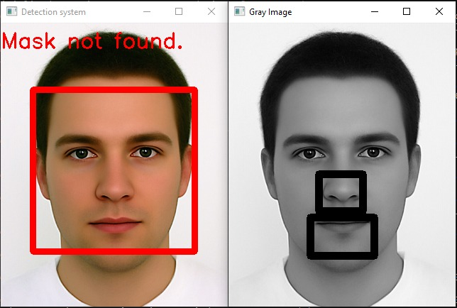
How it works?
Example from the projet:
After reading the trained XML files for the FACE ,MOUTH AND NOSE we convert the colored image from the video to a Gray image which gives better results.
we then Use “detectMultiScale()” to detect the FACE,MOUTH AND NOSE.

Slide 10
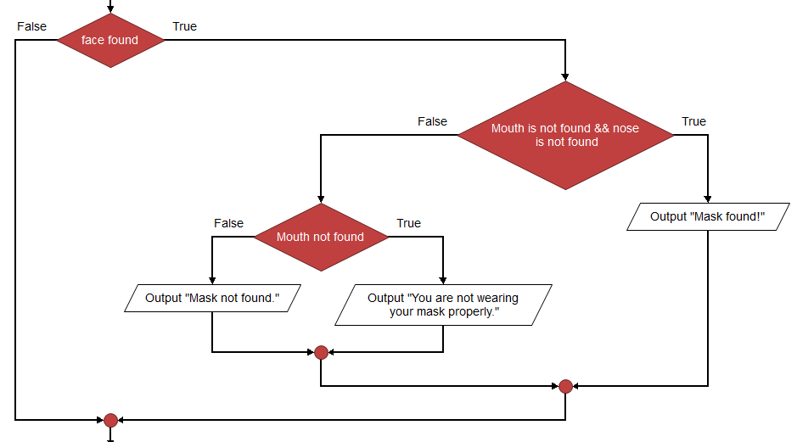
flowchart
Here’s a flowchart to determine if the person is wearing a mask or wearing it improperly or not wearing a mask at all!

Slide 11
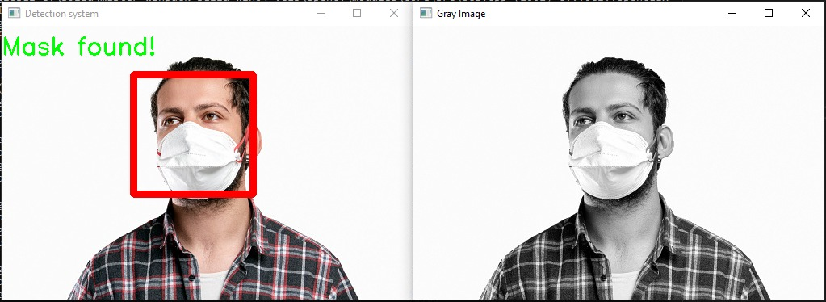
EXAMPLE
Example from the projet

Slide 12
03
Applications

Slide 13
Applications
Offices
schools
AIRPORTS
detect faces of employees who are not wearing a mask and give a warning.
Detect students who are not wearing a mask
to detect travelers without masks. If a traveler is found to be without a face mask, their picture is sent to the airport authorities so that they could take quick action.

Slide 14
04
OUR TEAM

Slide 15
Project x members:
Khalid Shiham
Ahmed Sameh
Zyad Mahmoud
Mohammed yasser
Hassan Hany
___

Slide 16

THANKS!
Supervised by: Dr/Esraa EL-hariri

